Slide 1

How safe is Toronto ?
Data Detectives (Group 8)

Slide 2



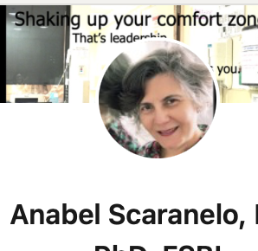
WHO WE ARE ?
The DATA Detectives
ZAID AL DULAIMI - TORONTO
LINTU BABY – WOODSTOCK
ANUMTA Khan – BRAMPTON
ANABEL SCARANELO – TORONTO

Slide 3

Disclosures
We do not have any financial interests.

Slide 4

Our goals
Identify
Identify the types of crimes in Toronto.
Analyze
Analyze the trend across the timeline and neighborhoods.
Create
Create awareness about the results of our data analysis and make you feel safer.

Slide 5
Learning Objectives
After this presentation you will know…
What are the top 3 most committed crimes
during the last 8 years.
What were the trends across past years. Can we predict next year ?
What premises type those crimes
happened.
What time of the day they were
prevalent.
What neighborhoods showed the
highest number of crimes?

Slide 6

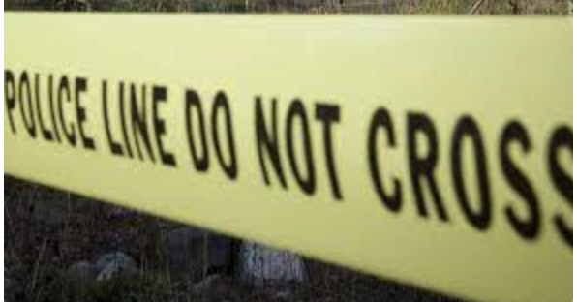
Brief Overview: API Toronto Police CSV files top 3 crimes
Used Jupyter Notebook for coding
URL = https://data.torontopolice.on.ca/pages/open-data

Slide 7
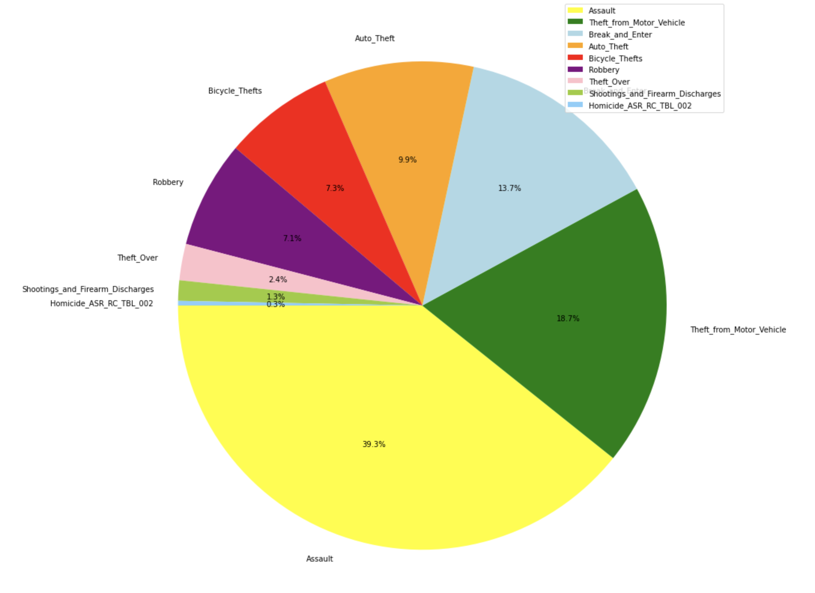
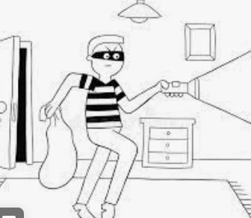



Slide 8
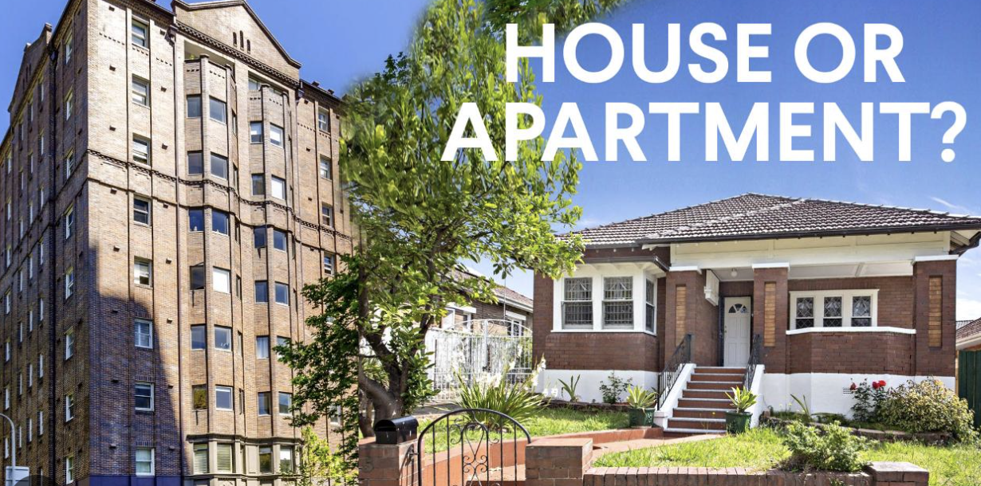
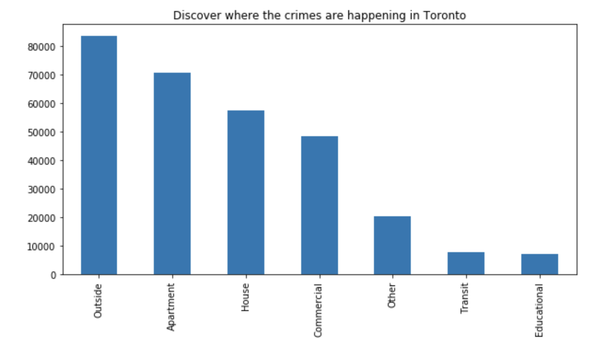
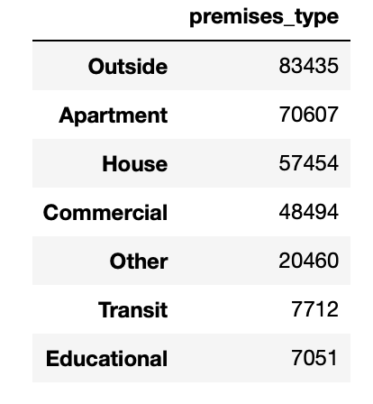

Slide 9

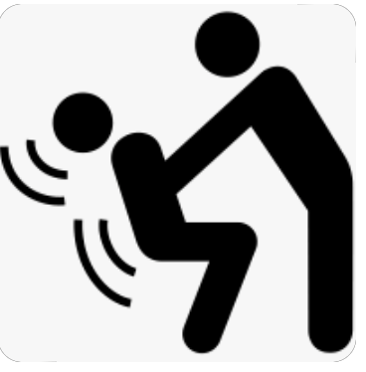
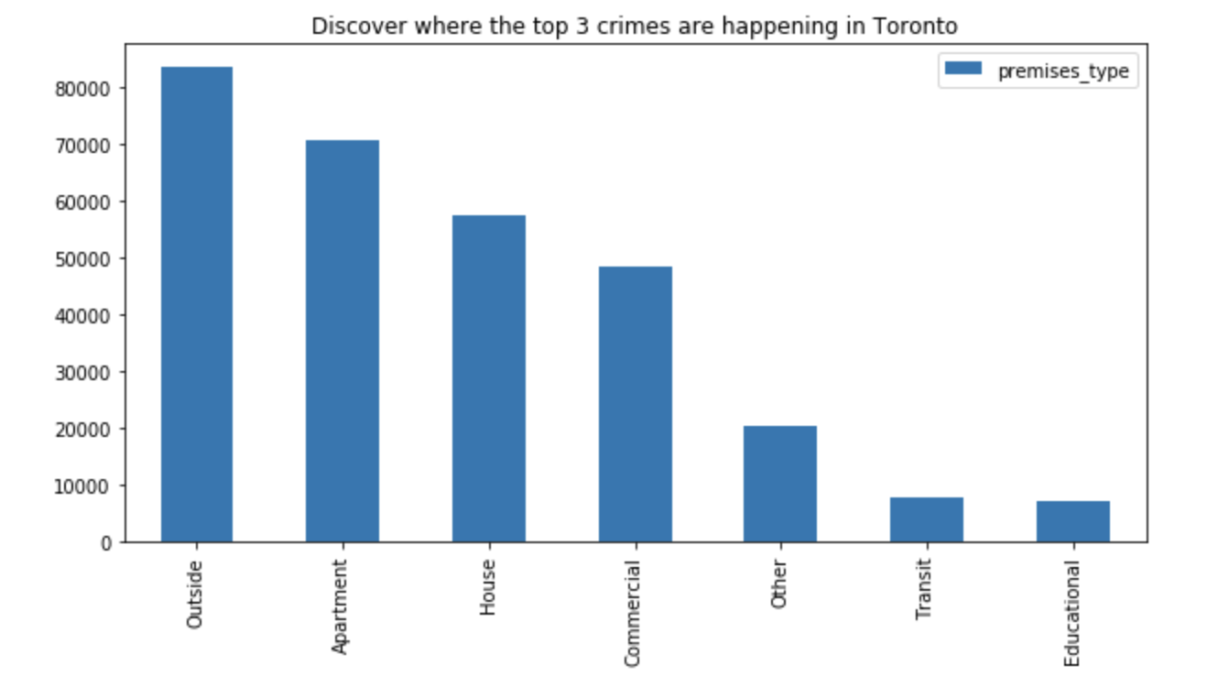
Data collection (combined top 3):
2014 to 2022

Slide 10
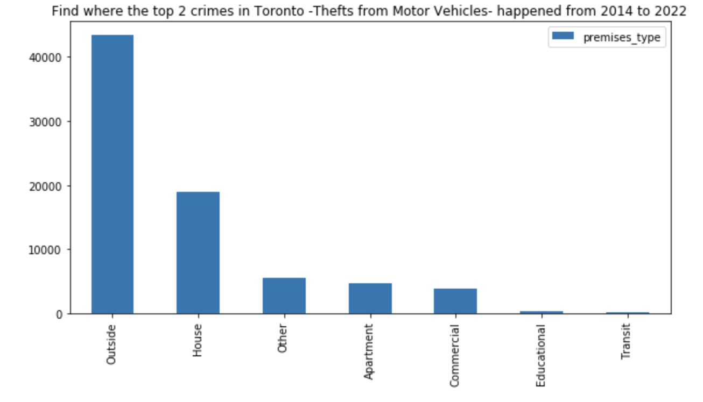
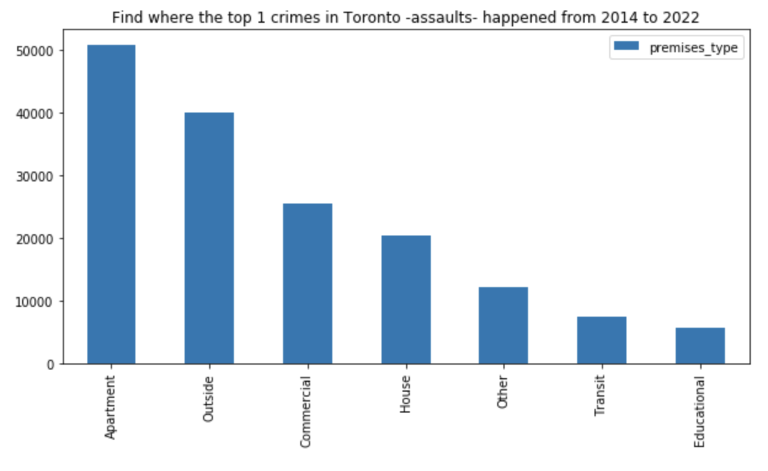
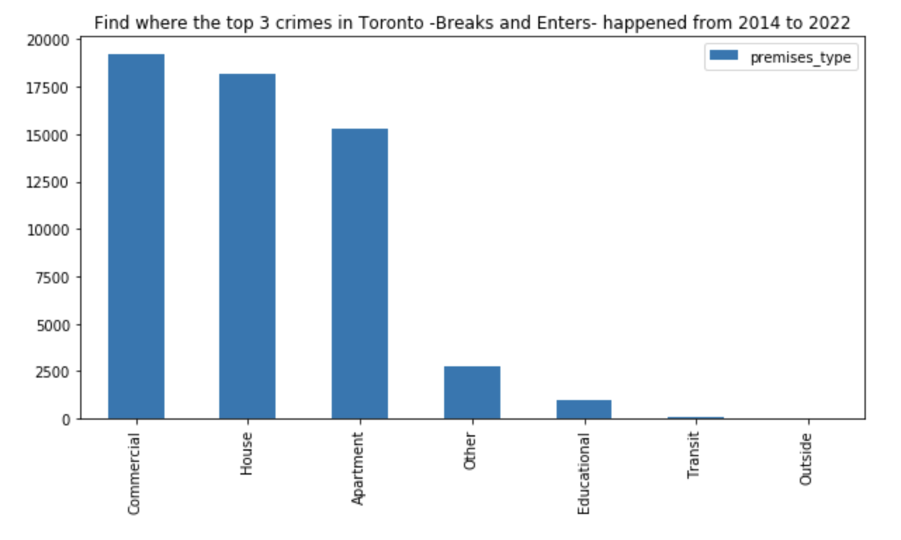
Data collection (not merged):
2014 to 2022
TAKE HOME LESSION:
If you don’t own a store on the streets of Toronto and live alone in a house without a car just taking transit, you may be subjected to less crimes than living with a partner in a condo in Toronto

Slide 11
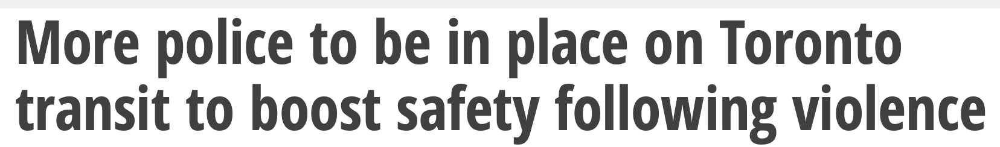

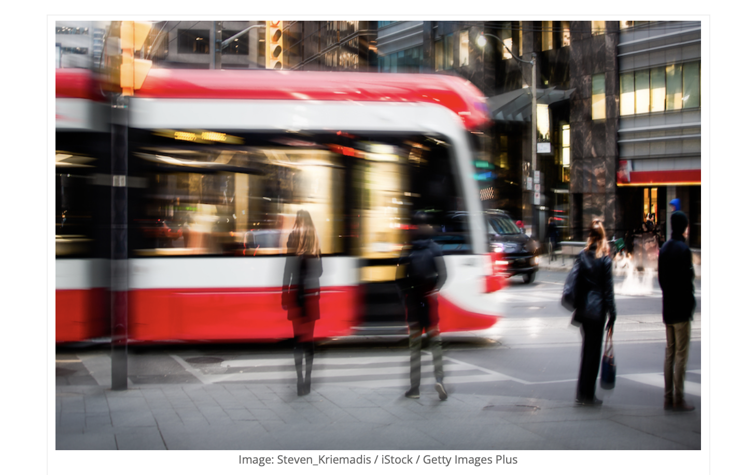

5
https://www.canadiansecuritymag.com/canadian-security-top-10-under-40-2023-now-open-for-nominations/

Slide 12

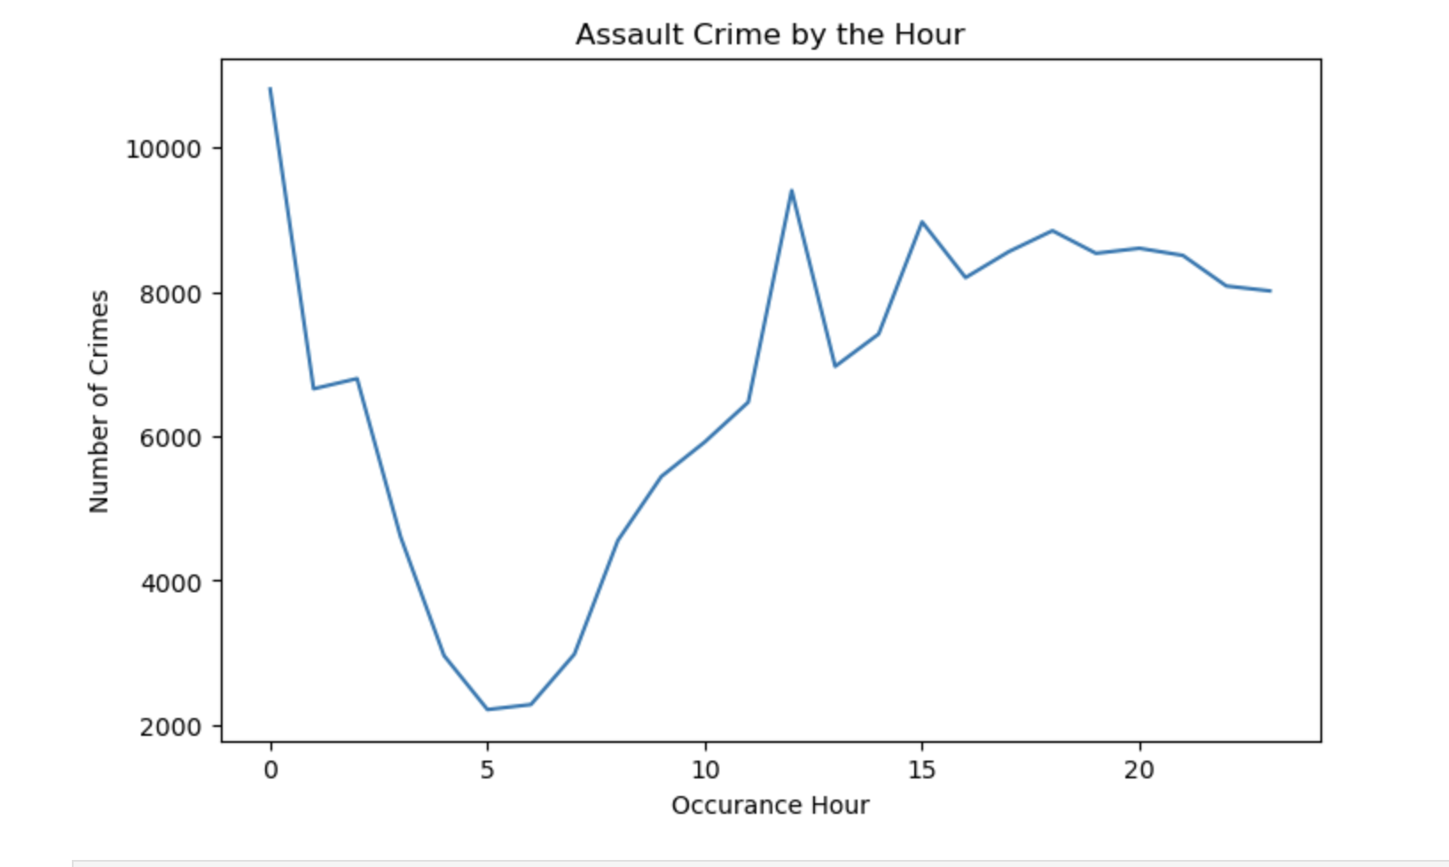

Slide 13

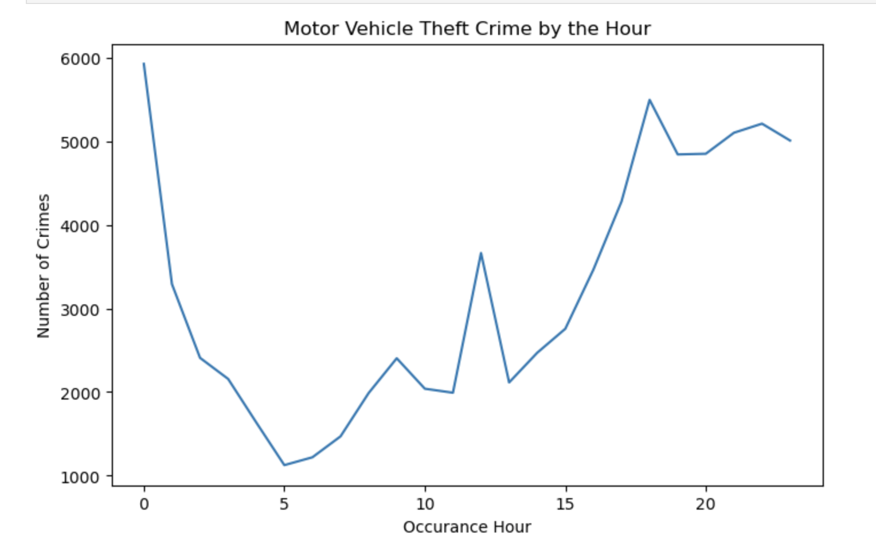

Slide 14

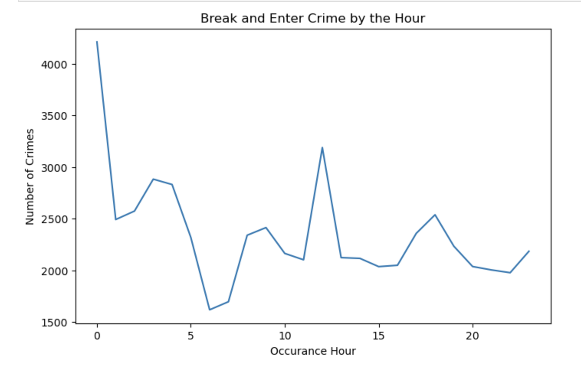

Slide 15
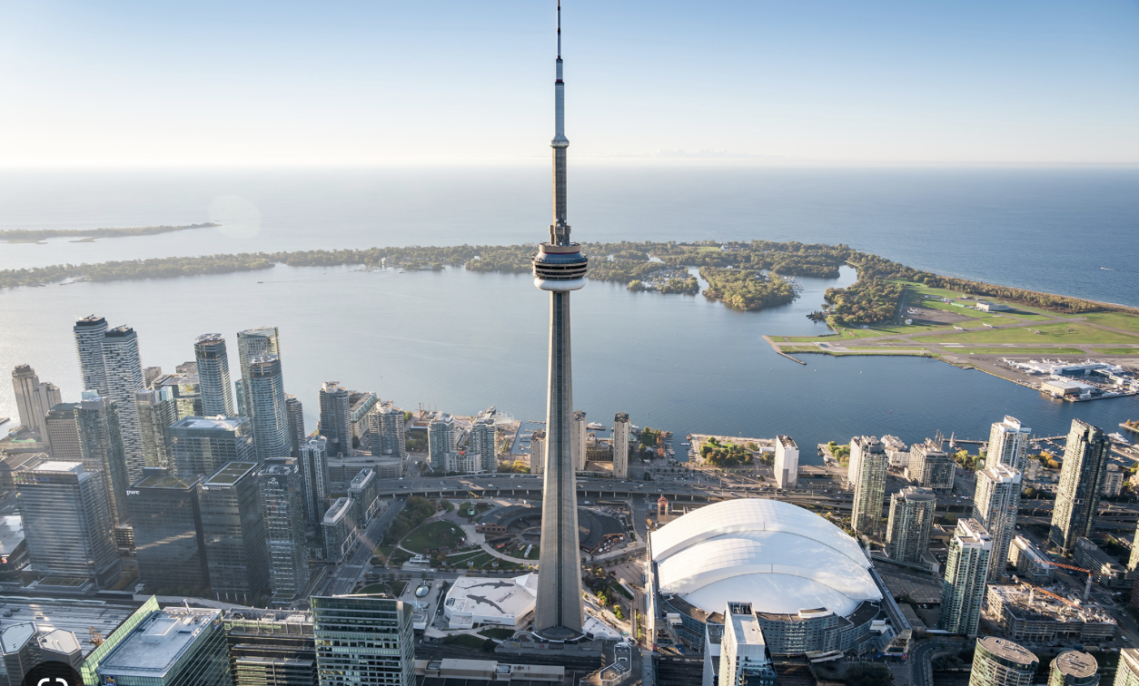
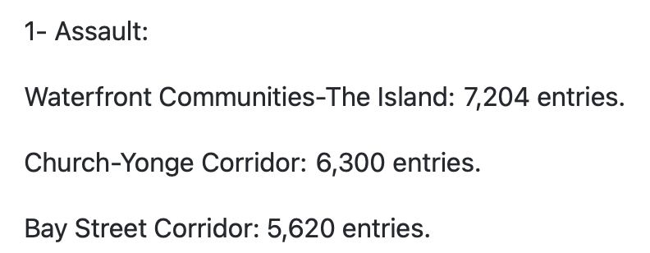
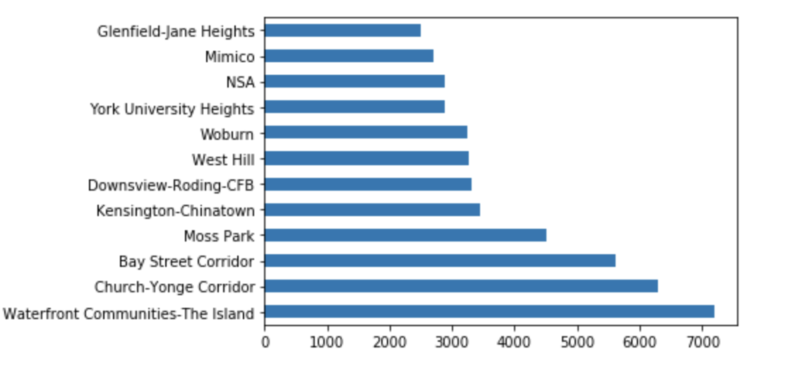

Slide 16
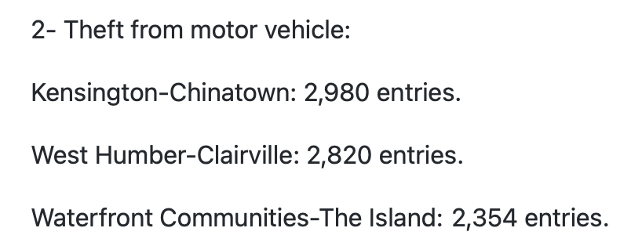
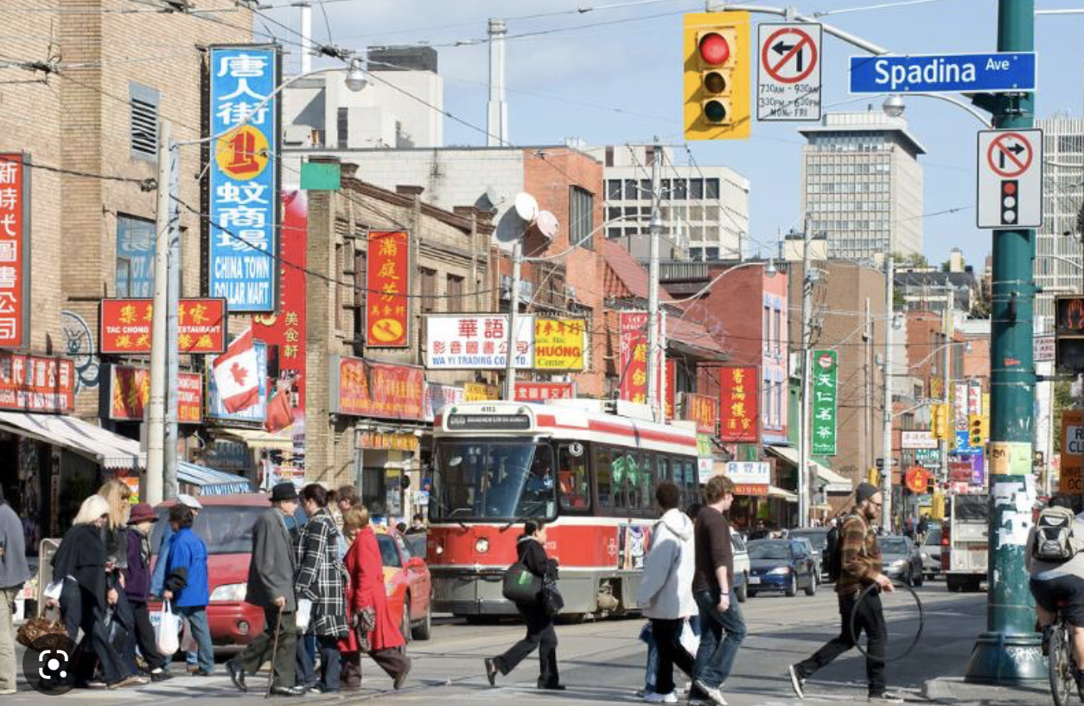
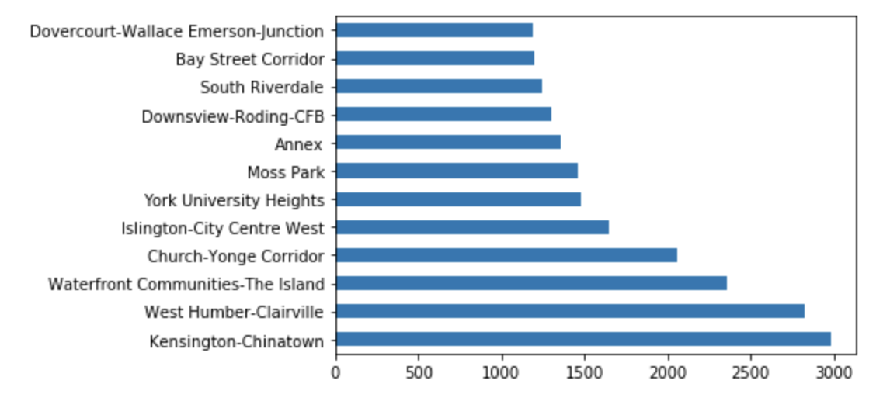

Slide 17
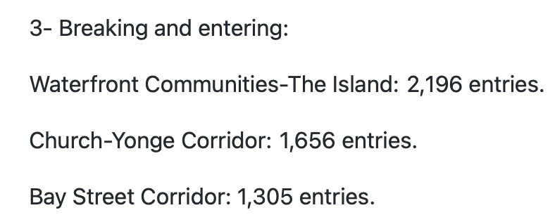
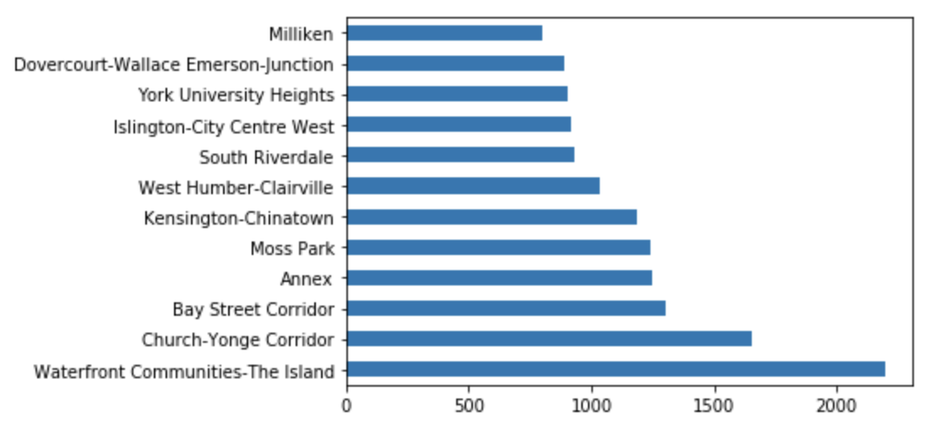

Slide 18
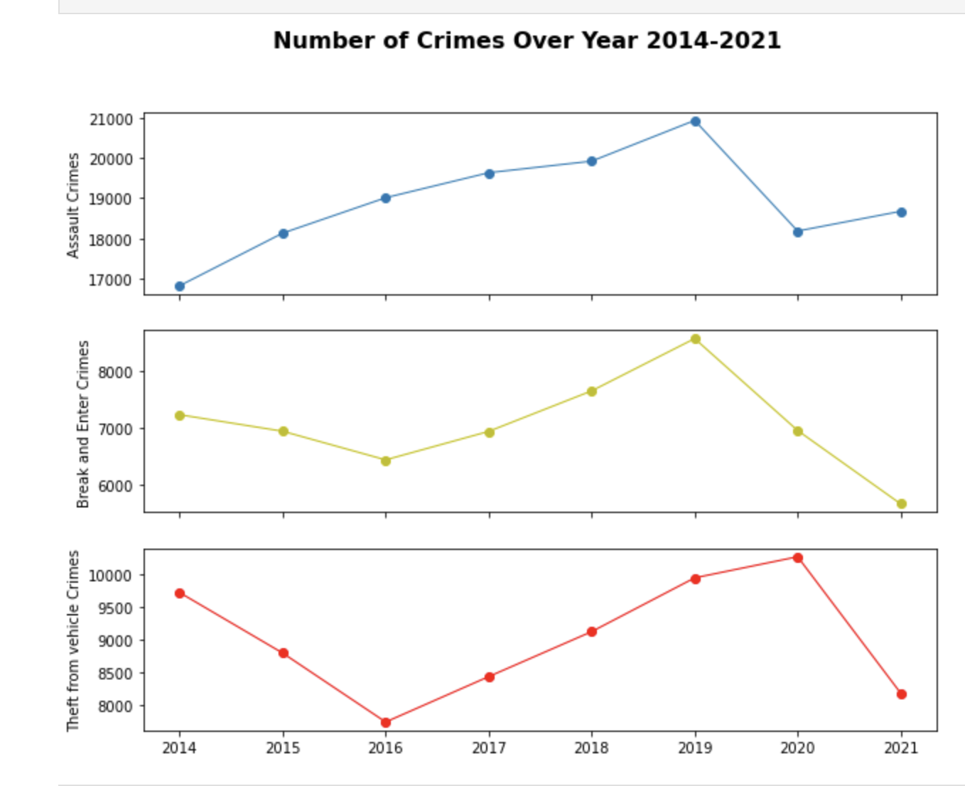

Slide 19
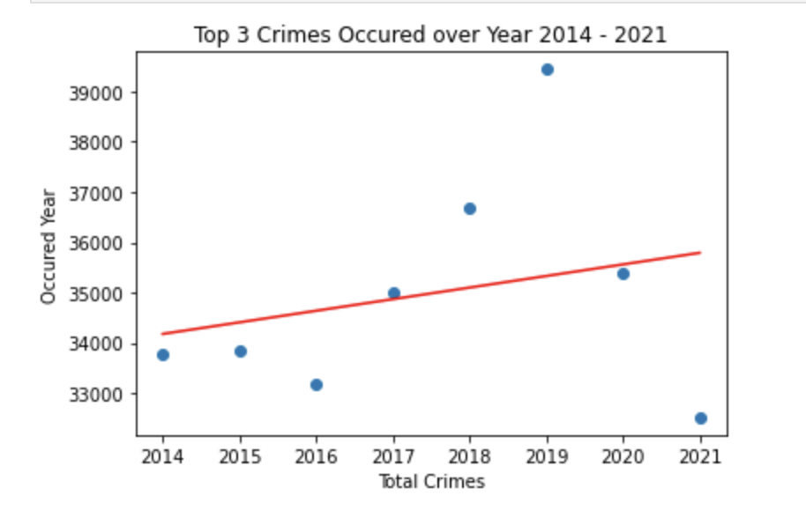

Slide 20


The number of crimes in 2023 forecasted as per this data analysis
will be of 36,251.

Slide 21




